Slide 1
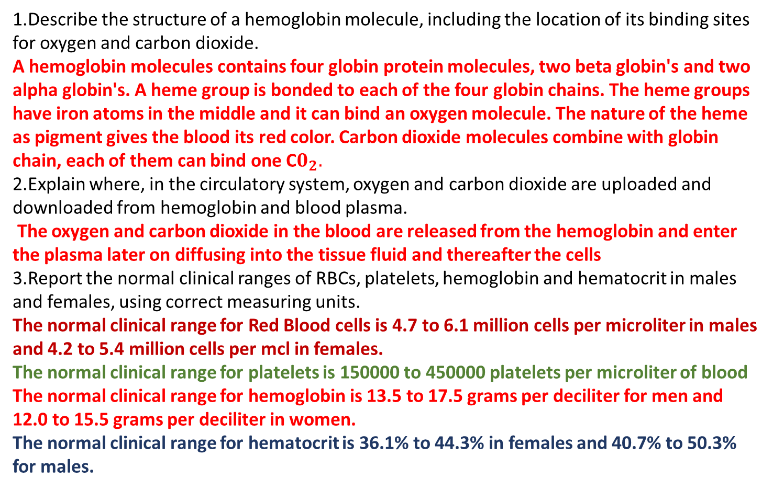
BIOL 2510 Learning Objectives 2AB
Lecture 2A
1.Describe the structure of a hemoglobin molecule, including the location of its binding sites for oxygen and carbon dioxide.
A hemoglobin molecules contains four globin protein molecules, two beta globin's and two alpha globin's. A heme group is bonded to each of the four globin chains. The heme groups have iron atoms in the middle and it can bind an oxygen molecule. The nature of the heme as pigment gives the blood its red color. Carbon dioxide molecules combine with globin chain, each of them can bind one C$0_{2}.$
2.Explain where, in the circulatory system, oxygen and carbon dioxide are uploaded and downloaded from hemoglobin and blood plasma.
The oxygen and carbon dioxide in the blood are released from the hemoglobin and enter the plasma later on diffusing into the tissue fluid and thereafter the cells
3.Report the normal clinical ranges of RBCs, platelets, hemoglobin and hematocrit in males and females, using correct measuring units.
The normal clinical range for Red Blood cells is 4.7 to 6.1 million cells per microliter in males and 4.2 to 5.4 million cells per mcl in females.
The normal clinical range for platelets is 150000 to 450000 platelets per microliter of blood
The normal clinical range for hemoglobin is 13.5 to 17.5 grams per deciliter for men and 12.0 to 15.5 grams per deciliter in women.
The normal clinical range for hematocrit is 36.1% to 44.3% in females and 40.7% to 50.3% for males.

Slide 2
4.Compare the % oxygen saturation of hemoglobin in arterial blood and venous blood.
The % of oxygen saturation of hemoglobin in the arterial blood is 95% whereas that in venous blood is lower as the blood returning to the right side of the heart.
5.Compare the partial pressure of oxygen in arterial blood and venous blood.
The partial pressure of oxygen in arterial blood is between 75mmHg to 200mmHg and 30mmHg to 40mmHg in venous blood
6.State the rate of RBC formation per second.
There are 2.4 newly produced Red Blood Cells per minute in human adults.
7.list, in order of differentiation, and distinguish among the functions of the red bone marrow precursor cells of erythrocytes
Through the production of red blood cells oxygen levels are maintained at the optimum,
The generation of fully developed red blood cells ensures the replacement of the worn out ones
The hormones involved help in hemoglobin formation
8.Explain why mature RBCs must use anaerobic respiration, and list two anaerobic pathways used by RBCs.
Red Blood Cells lack mitochondria and therefore use anaerobic respiration.
examples of anaerobic pathways used by Red Blood Cells are:
Embden-Meyerhof pathway
Hexose monophosphate shunt

Slide 3
9.Explain the requirements for each of these dietary substances in red blood cell production (erythropoiesis): Vitamin B12, folic acid, iron
The process requires folate and vitamin B12 at the differentiation phase for proliferation. Lack of these dietary substances impairs purine and thymidylate synthesis
10.Describe the intestinal absorption, blood transport and storage of iron.
The mucosal cells of the intestines in upper jejunum and duodenum facilitate the absorption of iron. The isron is paired to transferrin as it circulates and further transported to the cells of the body.
11.Explain the role of the kidneys in red blood cell production.
The kidneys activate Vitamin D which helps in the maintenance of bones and the production of erythropoietin which later plays a crucial role in the formation of red blood cells
12.State the lifespan of a red blood cell and describe the fate of the components of hemoglobin.
The lifespan of the red blood cells is 120 days, the hemoglobin content is released and Brocken down. Later on the iron in hemoglobin is transported to the bone marrow and later used for production of new Red Blood Cells

Slide 4
13.List the general clinical manifestations of anemia and note those related to stress response.
infection
fever
increased menstrual flow
nosebleeds
14.Describe the laboratory blood tests used to evaluate anemias.
Blood smear
CBC with platelets
Reticulocyte count
hemoglobin measure
15.List the three categories of anemia.
Aplastic Anemia
Anemia of Chronic Renal Failure
Iron Deficiency Anemia
16.Contrast the etiologies and clinical manifestations of the anemias related to low RBC count: aplastic anemia, anemia of chronic renal disease, anemia of Vitamin B12 deficiency (pernicious anemia) or folate deficiency, iron deficiency anemia
There maybe leukemia and bone marrow crowding in aplastic anemia and due to the low count of WBC the there is fever and chills.
There is secretuin secondary to kidney disease in chronic Renal Failure and clinical manifestation is Hematocrit falling

Slide 5
17.Contrast the clinical blood test results (CBC, platelets, MCV, MCH, blood smear) expected for the anemias related to low RBC count: aplastic anemia, anemia of chronic renal disease, anemia of Vitamin B12 deficiency (pernicious anemia) or folate deficiency, iron deficiency anemia.
The results show the low count of red blood cells and white bloodcells in aplastic anemia there is also extended bleeding time meaning platelets are not working properly. For the chronic renal disease the WBC and platelet count are normal. For folate deficiency and Vitamin B12 deficiency the results show RBC, WBC and platelet values are very small.
Lecture 2B
18.Explain the why these lab test results are elevated in hemolytic anemias: serum bilirubin, serum haptoglobin, reticulocyte count.
The lab test results are elevated in this case because the infections are more severe and have a high mutating potential.
19.Explain the effects of hemolytic anemia on EPO secretion, iron absorption and red bone marrow activity level.
Hemolytic anemia the bilirubin levels lower and therefore affecting the conjugation and excretion of bilirubin
20.Define splenomegaly, explain its occurrence in hemolytic anemia and state why splenectomy is associated with increased risk of infection.
Splenomegaly is the surgical process of the removal of the entire spleen in treating hemolytic anemia, however the process is associated with increased level of infection. This is because the spleen plays a crucial role in immunity and therefore removal may cause a lowering of the immunity.

Slide 6
21. Contrast the genetic defects (including gene names and chromosomal locations and gene products), populations most-affected, and clinical manifestations of the hemolytic anemias: alpha and beta thalassemia, sickle cell anemia, hereditary spherocytosis, G6PD deficiency
The genetic diseases can be passed on to the next generation as they are involved in genetics, in the hymoletic anemia the most affected population is Africa while alpha thalassemia is mainly in Asian population. Beta thalassemia is mainly in the Mediterranean. The hereditary spherocytosis and G6PD deficiency are mainly in Northern Europe and Jewish. The gene defect is undergoing mutation and mostly the HBB class.
22.Contrast the globin chain structure of these hemoglobin molecules and the circumstances of their presence: HbF, HbA, HbS, HbH, HbB
The HbF and HbA are perfectly compatible and have no fatal circumstances of their presence, HbS will cause sickle cell anemia and HbB and HbH will cause alpha and beta thalassemia.
23.Explain the relationship between malaria and the persistence of sickle cell anemia in areas where malaria is prevalent.
Study shows that the prevalence of malaria in emdemic areas potrays a selection for the carrier of the sickle cell anemia. This is considered as survival advantage and Malaria has been associated with a high mortality in people with sickle cell anemia.
24.Describe the usefulness of hydroxyurea in the treatment of sickle cell anemia and beta thalassemia.
Hydroxyurea has the capacity to enlarge red blood cells and therefore making them more flexible and better shape. In turn this lowers the chances that they turn into sickle shape, furthermore there is a notable increase in hemoglobin F

Slide 7
25.Explain why alpha thalassemia major is fatal before birth, while beta thalassemia major is not.
Alpha thalassemia is lethal before birth because of lack of alpha chains therefore there is no Hb F and Hb A, without these two life cannot be formed.
26.Describe the etiology of hemolytic disease of the newborn (HDNB).
The serious form occurs when R+ fetus is carried by a R- mother
If the fetus is R+ and his red blood cells enter the mothers blood the body is sensitized against the Rh antigen on the fetus and begins to organize a primary system to fight back
27.Describe the contents of Rho Gam and explain how it prevents HDNB.
If a patient is Rh- and have not been sensitized yet the one is administered Rh immunoglobulin( RhoGAM)
Its effect is the stoppage of antibodies from reacting to the young fetus Rh+ cells
28.Explain how drugs can cause hemolytic anemia.
Drug induced hemolytic anemia is rare however its cases are still evident, some of the drugs that can cause this type of anemia are: Dapsone, levodopa. Methyldopa and penicillin amongst others. The condition occurs when a medicine triggers the body to defend itself. Therefore causing the breakdown of read blood cells prior to their time.

Slide 8
29.Explain the common causes of severe blood loss and its treatment.
Serious cuts
Blunt traumatic injury
Vaginal bleeding
Endometriosis
The treatment method for this case is aggressive fluid resuscitation.
30.Contrast the etiologies of polycythemia vera, secondary polycythemia and relative polycythemia.
There is abnormalities in the production of red blood cells and therefore signifying an increase in the red cell count. In the other types there are factors external to the RBC production which include tumors and hypoxia,
31.List and describe the two components of primary hemostasis and the two components of secondary hemostasis.
There two components of primary hemostasis:
Platelet aggregation this is the activation
Platelet plug formation is the creation of a plug at the site of injury
The two components of secondary hemostasis:
Proteolytic coagulation which is the deposition of insoluble fibrin
The insoluble fibrin forms a mesh that incorporates itself around the plug formed.

Slide 9
32.List the chemicals that keep platelets inactive when they are not needed.
Aspirin, Brilinta, Plavix, effient, pletal
These chemicals inhibit the formation and plugging of platelets therefore are not necessary.
33.List, in order, the steps in the process of platelet plug formation.
Platelet Adherence, Platelet activation and Platelet aggregation.
34.Define each of these platelet functions: adherence, degranulation, aggregation, recruitment.
Adherence- the single platelet binds through a specific membrane receptors to the cellular and outside matrix that constitute the vessel walls and the tissues
Degranulation- is the factor of platelets that responds to the aggregating agents
Aggregation- this is the clumping together of the platelets inside the blood
Recruitment the incorporation of circulation neutrophils that in turn destroy the entrapped pathogens
35.Describe the intrinsic, extrinsic and common pathways of coagulation, including the end product of each pathway and type of ion required for all three pathways.
The intrinsic pathway consists of various factors namely: I,II,IX,X,XI & XII
The extrinsic pathway consists of factors I,II,VII and X Fibrin
The common pathway consists of I,II,V,VII and X, the end product is fibrinogen.
36.Explain how blood clots are removed once they have served their purpose.
The body naturally dissolves the blood clot after it has served its purpose, there are also other ways of removing the clot like Thrombectomy which is a surgical procedure.

Slide 10
37. Contrast the effect of these chemicals on blood clot formation and categorize each as an antiplatelet, anticoagulant or thrombolytic: aspirin, heparin, warfarin, antithrombin III, tPA
Aspirin is an antiplatelet because of its effect on blood clot formation, the heparin however activates the enzyme antithrombin III and therefore is anticoagulant. Warfarin and antithrombin III both also share as anticoagulants too and tPA is a thrombolytic category as it converts plasminogen into Plasmin and later breakdown fiber

